Slide 1




week_three
Data Science and Machine learning track.
By
Mal. Umar Ibrahim
Federal university Dutse
Miss Muhammad Fatima Adam
Federal university Dutse
Mal. Abubakar Yakubu Zandam
Federal university of Technology Babura

Slide 2
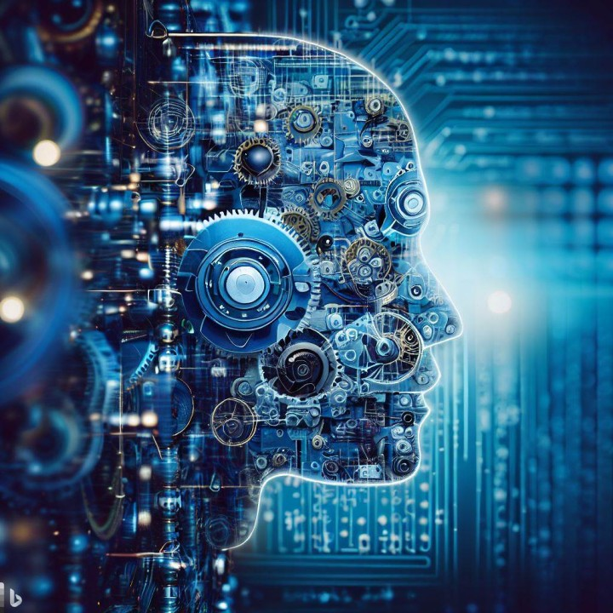
What is Machine learning?

Slide 3
Machine learning is a powerful technology enabling computers to "learn" from data without being explicitly programmed. Just like we learn from experience, machines analyze patterns and relationships within data to make predictions or decisions on new, unseen data.

Slide 4
Contents:
Introduction - recap
Concept of Machine Learning Models
Machine Learning Algorithms and Models
Machine Learning Tasks
Model Building Process
Data Splitting
Model Training
Model Testing and Evaluation
Practical Guide
Q and A

Slide 5
Introduction
Understanding machine learning models is understanding what machine learning is.
Recap:
Machine learning arises from this question:
Could a computer go beyond “what we know how to order it to perform” and learn on its own how to perform a specified task?
Rather than programmers crafting data-processing rules by hand, could a computer surprise us?
Could a computer automatically learn these rules by looking at data ?

Slide 6
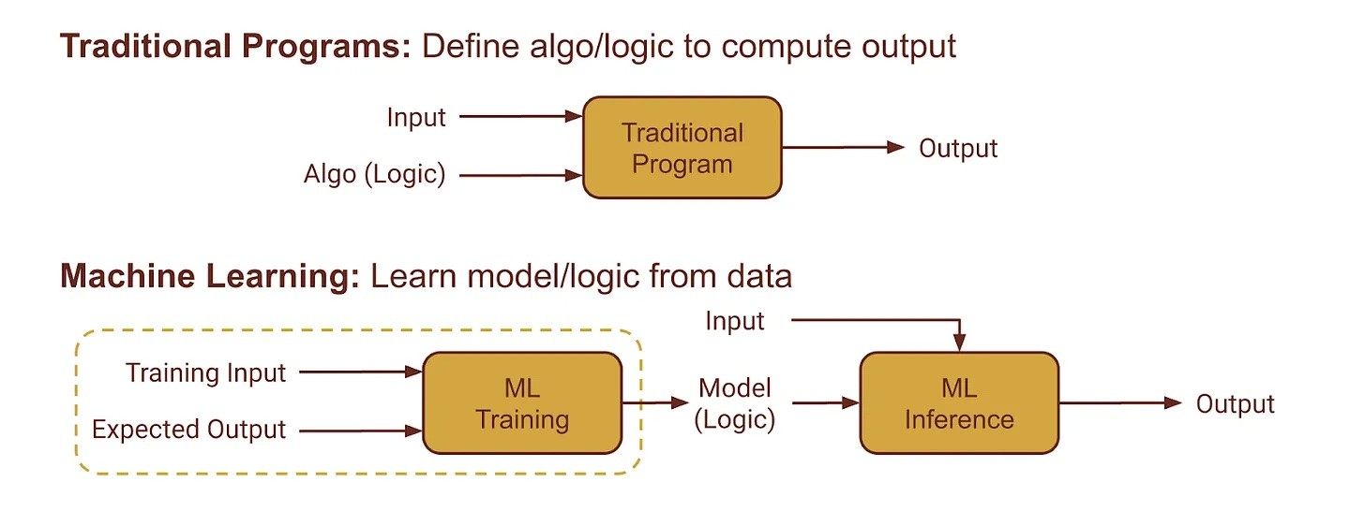
Introduction (Cont.)

Slide 7
Machine Learning Model Concept
Machine-learning system is trained rather than explicitly programmed.
It’s presented with many examples relevant to a task, and it finds statistical structure in these examples that eventually allows the system to come up with rules for automating the task.
Therefore, the central problem in machine learning is to meaningfully transform data: in other words, to learn useful representations of the input data at hand—representations that get us closer to the expected output.
A representation is a different way to look at data—to represent or encode data.
Machine-learning models are all about finding appropriate representations for their input data
That is, transformations of the data that make it more amenable to the task at hand, such as a classification task.

Slide 8
Machine Learning Model Concept(Cont.)
In simple term, representation simply means mapping input data
Consider a given example:
Giving this pairs of numbers (1,1), (2,4), (4,16), (100,10000), (20, 400), … (m, n)
How is the above data be represented
How do we find (m, n)? n = m², right?
This rule can be represented as f(x) 🡪 x²
The function here f(x), can be thought of as the machine learning model, and the mapping f(x) 🡪 x² as the rule or representation.
All machine-learning algorithms consist of automatically finding such transformations that turn data into more-useful representations for a given task.
This is known as model fitting

Slide 9
Machine Learning Model Concept(Cont.)
These concepts are fundamental to understanding how machine learning works
Data
Structured (in tables), Unstructured (text, images, audio)
Dataset for ML can be labelled or unlabelled
Features
Individual characteristics or attributes of the data
Algorithm
Mathematical and statistical techniques that are used to learn patterns in data
Model
The result of training an algorithm on a dataset
Training
Simply fitting machine learning algorithm to data
Testing and Evaluation
Model Deployment

Slide 10
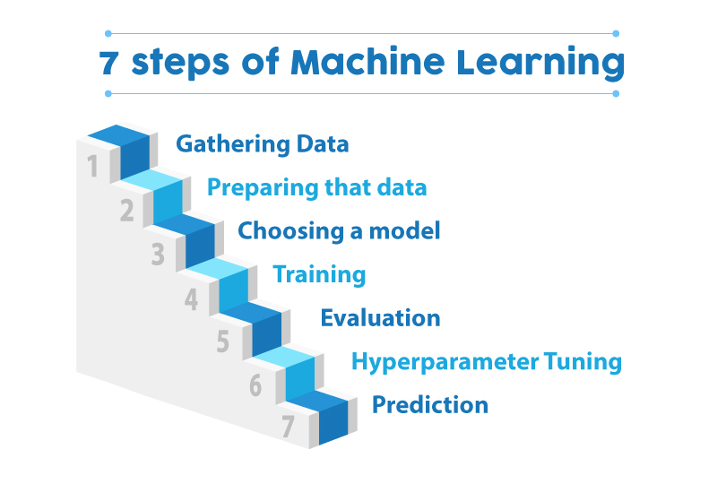

Slide 11
Reflect
What are the inputs to the following
Classical/Traditional Programming
Machine Learning
What is similar and what is different in (a) and (b) above

Slide 12
Machine Learning Algorithm and Model
ML algorithms and models are closely related concepts, but they served different roles.
ML Algorithms
Instructions that guide the learning process in machine learning.
Set of the mathematical and statistical techniques that are used to learn patterns, relationships, or rules.
Define the way a model learns from data.
ML Models
Are tangible outcomes of applying machine learning algorithms to data.
Consists of a set of a learned parameters, which have been optimized to fit the data and make accurate predictions.
Example,
consider the linear function y = mx + c as an algorithm,
therefore any relationship derived based on that function can be seen a model of that function, e.g. y = 2x + 1

Slide 13
Reflect
All ML models are ML algorithms, True or False, Why
Can algorithm be derived from model? why
How many models can we have from an algorithm?

Slide 14
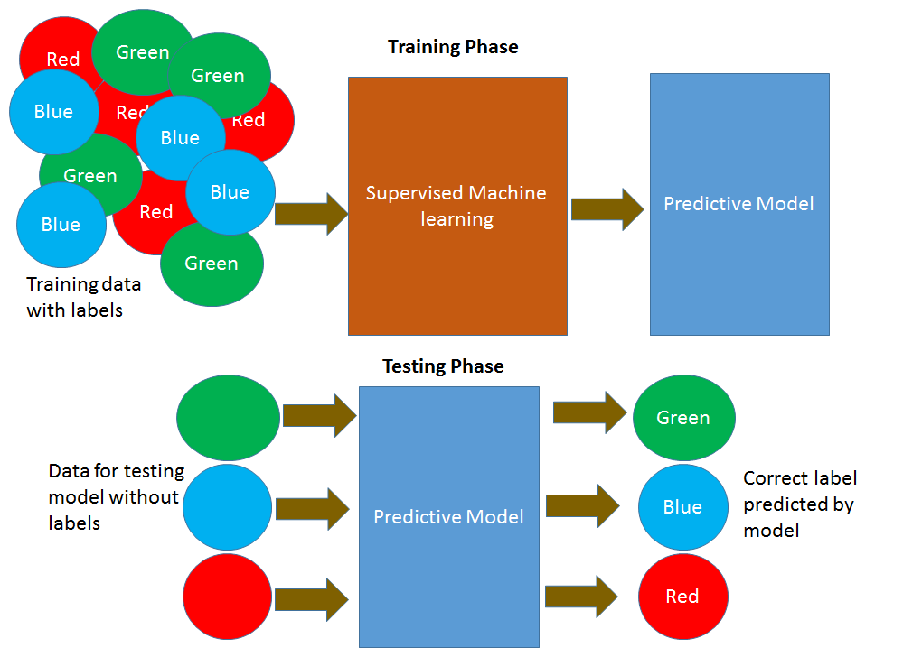
Types of datasets
Labelled Dataset
Unlabelled Dataset

Slide 15
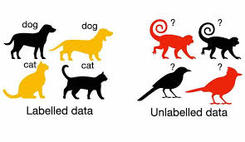

Slide 16
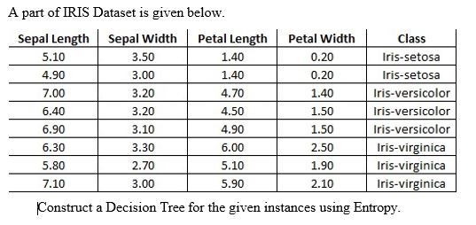
Labeled Dataset

Slide 17
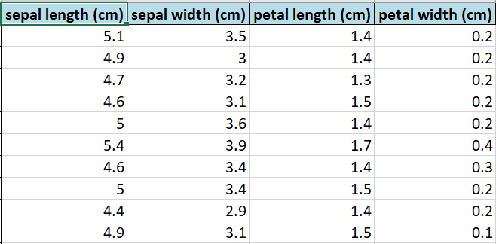
Unlabeled Dataset

Slide 18
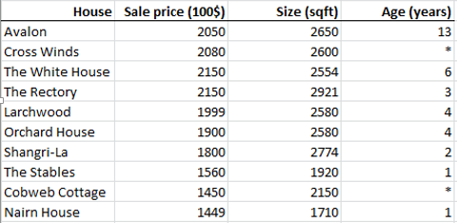
Reflect
Is this labeled or unlabeled data?

Slide 19
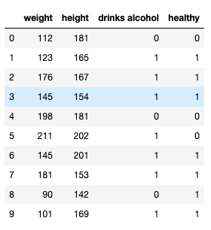
Reflect
Is this labeled or unlabeled data?

Slide 20
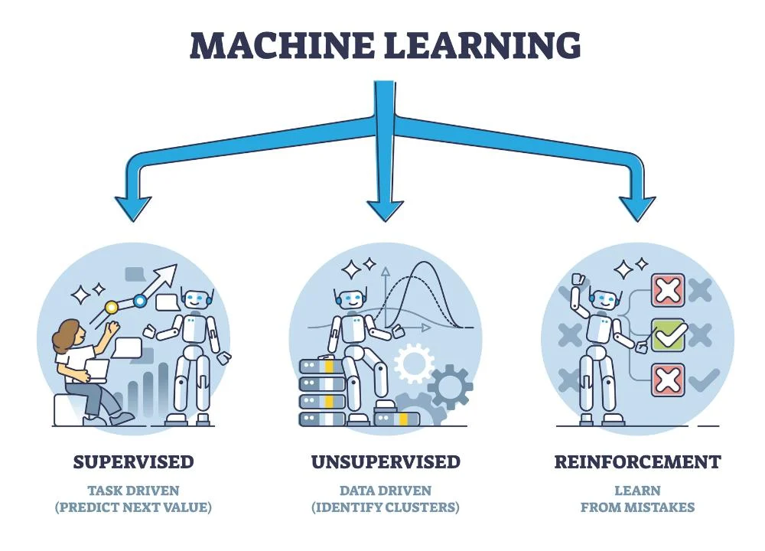
Machine Learning Task

Slide 21
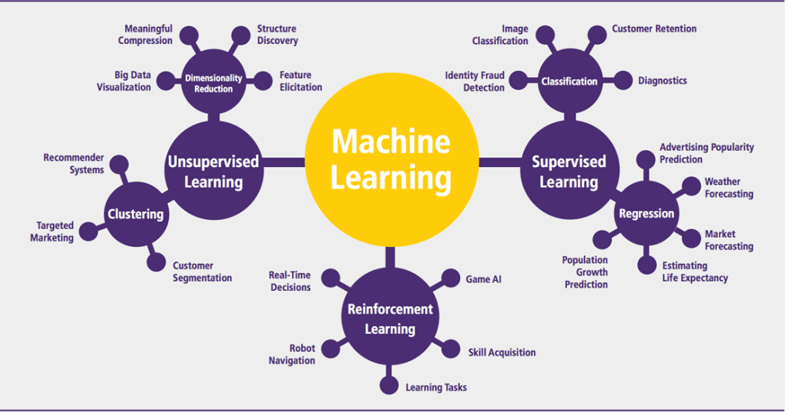
Machine Learning Task

Slide 22
Supervised ML
Let's talk about the datasets that have both input and target variables (labelled data).
ranging from predicting a person's survival rate in Titanic Dataset, where Survival Rate is already given,
to predicting the House Price according to house characteristics where the house prices are provided.
The algorithms that work on such datasets are known as Supervised Learning Algorithms.
It is called supervised learning because the process of an algorithm learning from the training dataset can be thought of as a teacher supervising the learning process.
Types of Supervised Learning Algorithms
Classification
Regression

Slide 23

What should I consider before choosing between a regression and a classification model?

Slide 24
1. What is the target variable?
Regression: The target variable should be continuous, like temperature, house price, or stock market trends.
Classification: The target variable should be categorical, with distinct classes like spam/not spam, fraud/not fraud, or animal species.
2. What is the goal of the model?
Regression: Do you want to predict a continuous value? How accurate do the predictions need to be?
Classification: Do you want to categorize data points into predefined classes? Are false positives or false negatives more critical to avoid?
3. What type of data do you have?
Regression: Both features and the target variable are typically numerical. Some models can handle categorical features, but encoding them is necessary.
Classification: Features can be numerical or categorical, but the target variable usually represents distinct categories. Some models require numerical features.

Slide 25
4. What is the complexity of the data?
Regression: Linear relationships might be sufficient for simpler problems, while complex relationships might require more advanced models.
Classification: The number of classes and the complexity of data relationships influence the choice of model.
5. What are the available resources?
Regression: Some regression models might be computationally expensive compared to simpler classification models.
Classification: Certain classification algorithms like neural networks require significant training data and computational resources.

Slide 26
Supervised ML - Classification_classes
When the number of classes is 2, it is known as Binary Classification.
E.g. whether it will be hot or cold tomorrow is a binary classification problem with two categories: Hot and Cold.
When it is more than 2, it is known as Multi-Class Classification.
E.g., classifying movies as Good, Average, or Bad according to reviews.
ML algorithms for classification problems include:
Decision Tree,
Support Vector Machine,
Naïve Bayes,
Random Forest, etc.

Slide 27
Reflect
Identify the following as classification problem or otherwise
Spam email detection
Weather forecast
Employability prediction
Dollar price prediction
Stock price prediction
Identify the following as binary or multiclass classification
Spam email detection
Gender identification
Classifying a sentiment on positive, negative neutral

Slide 28
Supervised ML - Regression
The most used regression algorithm is the Linear Regression
Linear regression is a linear model, i.e., a model that assumes a linear relationship (straight-line relationship) between the input variables (x) and the single output variable (y).
When there is a single input variable (x), the method is called simple linear regression or just linear regression.
E.g., the dataset consisting salary and years of experience. There is only one target variable and one input variable where we are predicting the salary of individuals using their years of experience.
When there are multiple input variables, it is often referred to as multiple linear regression.
E.g., House price prediction data set, we have multiple input variables.

Slide 29
Unsupervised ML
Unsupervised learning is where you have unlabelled data (or no target variable) in the dataset.
The Learning Algorithms goal is to find some structure, patterns, or relationships in the dataset.
These are called unsupervised learning because algorithms are left on their own to discover and present the interesting structure in the data.
K-Means Clustering
Hierarchical Clustering
Clustering
groups similar data points together into clusters or categories.
Anomaly Reduction
Detecting anomalies or outliers in a data.
Behavioural Analysis
analysing user behaviour on websites or applications.

Slide 30
Reinforcement ML
Reinforcement is a type of learning where an agent learns to make decisions by interacting with an environment.
A robot takes a big step forward, then falls. The next time, it takes a smaller step and is able to hold its balance.
The robot tries variations like this many times; eventually, it learns the right size of steps to take and walks steadily. It has succeeded.
This is called reinforcement learning. The robot learns how to walk based on reward (staying on balance) and punishment (falling).
This feedback is considered "reinforcement" for doing or not doing an action.
In simple terms, reinforcement learning is learning the best actions based on reward or punishment.
Example include: robot navigation, AI games, real-time decision, etc.

Slide 31
Model Building Process
Data Splitting
Involves dividing the dataset into multiple subsets for training, validation, and testing.
Train-Validation-Test Split
Data is divided into training, validation and test sets.
K-Fold Cross-Validation
Used when the dataset is limited
Data is divided into ‘K’ equally sized subsets (folds)
Stratified Sampling
Useful when having imbalanced classes in the dataset
E.g. Yes – 80%, No – 20%
Time-Based Splitting
Applicable to time series data
Random Sampling
Randomly shuffle the dataset and split it into training, validation and testing

Slide 32
Model Building Process (Cont.)
Model Training
Involves training the machine learning algorithm to learns from the dataset.
Include feeding the algorithm with both data and answers and obtaining rule as the output
In other word, fitting the machine learning algorithm search for relationship in the dataset.
Selecting a Model
Depends on the factor like data type, classification, regression, etc
Model Initialization
Initialize the model parameters depending on the chosen model.
Hyperparameter Tuning
Experiment with different hyperparameters, batch size, learning rate, etc.
Early Stopping
Monitor the model performance to prevent overfitting

Slide 33
Model Building Process (Cont.)
Model Testing and Evaluation
Testing and evaluation determine how well the model is expected to perform on new, unseen data.
Testing
Load the machine learning model trained during the training phase.
Simply, using the fitted model on an unseen data.
Include only feeding the model with data and obtaining prediction as the output
Evaluation Metrics
Classification Metrics, accuracy, precision, recall, F1-Score, Confusion Matrix
Regression Metrics, MAE, MSE, RMSE
Unsupervised Metrics, Silhoutte Score, Inertia, Precision, Recall
Visualizations
Create visualizations such as on confusion matrix, precision-recall

Slide 34
Reflect
During ML model training,
What are the inputs to the model?
What is the output?
During ML model testing,
What is the input to the model?
What is the output?

Slide 35
Pre-Practical Guide
Decision Tree
A decision tree is a flowchart-like tree structure where an internal node represents a feature (or attribute), the branch represents a decision rule, and each leaf node represents the outcome.
The topmost node in a decision tree is known as the root node. It learns to partition on the basis of the attribute value.
It partitions the tree in a recursive manner called recursive partitioning. This flowchart-like structure helps you in decision-making.
It's visualization like a flowchart diagram which easily mimics the human level thinking. That is why decision trees are easy to understand and interpret.

Slide 36
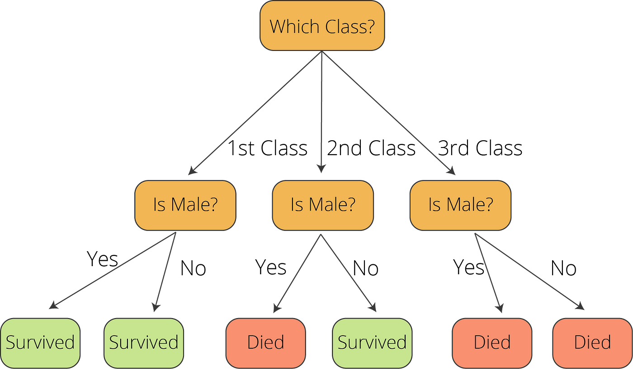
Pre-Practical Guide
Decision Tree Classifier
Determining titanic survival

Slide 37
Reflect
What type of machine learning task is Decision Tree use for?
The titanic survivor classification example, is it a binary or multiclass?
Next, See Notebook

Slide 38
Pre-Practical Guide (Cont.)
Linear Regression
Suppose we have a dataset which contains information about relationship between 'Years of experience' and 'Salary' in a particular work field.
Representing the experience with variable x and salary with y, we can say that y ∝ x.
However, a change in x does not usually mean an equal change in y.
Let's add a coefficient b1 to our example.
We thus get y = b1*x
Now the salaries in a particular job always start with the base amount or the lowest possible salary. We thus need to take that constant in consideration.
The constant b0 would be the starting salary for someone with a zero level of experience. Assuming every fresher in the company gets 30K as starting salary we can set it as the base price.
Finally, we have:
Salary = b0 + b1* Experience, or just y = b0 + b1*x
This is a simple linear equation, y = mx + c

Slide 39
Reflect
What type of machine learning task is Linear Regression use for?
What is the name of Linear Regression when there is a single data input?
What is the name of Linear Regression when there is multiple data input?
Next, See Notebook

Slide 40


